Slide 1
Bobcats Beyond the Classroom: Life Skills for Success

Slide 2
Why this? Why Now?
Educate the whole student
Support and complement GC Journeys high-impact practices
Provide students with the skills and experience that employers are seeking in the workplace
Re-engage students in the co-curriculum Post COVID-19 pandemic
Provide students with life skills to help them prepare for life after Georgia College & State University
Notes:
Bobcats Beyond the Classroom (Life Skills for Success) was created to foster a more comprehensive collegiate experience complementing the world-class education students receive in the classroom.
This program is available to all Georgia College & State University undergraduate students.
Bobcats Beyond is comprised of 10 categories focused on helping students develop and articulate skills needed to be successful personally, academically, and professionally.
The basis of the program is to:
Educate the whole student
Support and complement GC Journeys high-impact practices
Provide students with the skills and experience that employers are seeking in the workplace
Re-engage students in the co-curriculum Post COVID-19 pandemic
Provide students with life skills to help them prepare for life after Georgia College & State University
Students will:
Be provided with structure to the Co-curricular Experience
Be exposed to important life skills
Track their experiences and be provided a Co-curricular Record
Engage in opportunities that will allow them to integrate knowledge from their co-curricular activities and personal experiences to develop critical and creative thinking skills
Develop interpersonal competence

Slide 3
Helping students develop the skills employers want
Notes:
Teamwork Skills 76.00% Written Communication Skills 73.30% Leadership 60.30% Verbal Communication Skills 58.80% Interpersonal Skills 56.50%
National Association of Colleges and Employers 2022 Survey

Slide 4
Program Overview
Each program in the system will fall into one or more of 10 categories
Students accumulate points for participation
Recognition of levels of participation within each program category
Students who complete the required number of experiences for all 10 categories are invite to join the "Green and Blue Society"
Students can track their participation on their dashboard in GC Connect
Notes:
Recognition levels:
Bronze
Silver
Gold
Platinum – Automatically reached with the completion of corresponding GC Journeys experience.

Slide 5
Program Categories
Leadership Development
Communication Skills
Career Development
Mental Health and Wellbeing
Financial Literacy
Physical Health, Fitness, and Wellness
Intercultural and Global Understanding
Civic Engagement and Social Responsibility
Appreciation of the Arts
Bobcat Pride/Campus Involvement

Slide 6
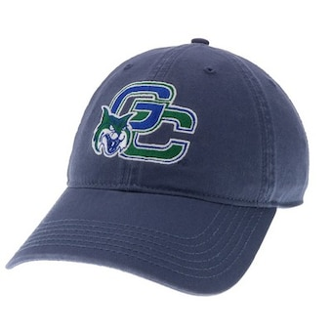
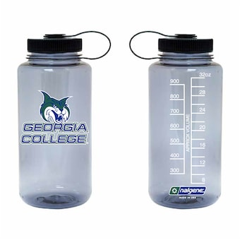
PARTICIPATION & COMPLETION INCENTIVES
Points can be redeemed for GCSU gear or other incentives based on level of participation and points accumulated
Students who complete the program will:
Gain admission to the Green and Blue Society
Receive a cord of recognition for graduation
Be invited to special events with employers and grad/professional schools, and alumni

Slide 7
Contact Information
Lauren Easom
Director, Career Services
& Bobcats Beyond Program Coordinator
478-445-5384
Bobcatsbeyond@gcsu.edu
The Office of Student Life
478-445-5169
vpstudentlife@gcsu.edu
https://www.gcsu.edu/studentlife/bobcats-beyond-the-classroom

