Slide 1
SACS 5th Year Interim Report Update
University Senate Meeting
January 25, 2010

Slide 2
General Issues
Required to report on 14 Standards, including all the Federal Requirements
Core requirements: must be found in compliance
Core Requirement 2.10
The institution provides student support programs, services, and activities consistent with its mission that promote student learning and enhance the development of its students.
Connects to learning outcomes
Controversial in Student Affairs and rarely done
Reliance on indirect data, such as from NASPA surveys
Similar issue for facilities standard CS 3.11.3

Slide 3
General Issues
Many standards, such as CR 2.10, require a demonstration of compliance that is linked to the institutional mission statement
Must derive and/or link learning goals from the mission statement
2004 Reaffirmation issues with mission statement
Recent mission review retreat

Slide 4
General Issues
Need to keep documentation of our actual application of policies
Federal Requirement 4.5 The institution has adequate procedures for addressing written student complaints and is responsible for demonstrating that it follows those procedures when resolving student complaints.

Slide 5
General Issues
We need readily available data!

Slide 6
General Issues
CS 3.3.1.1
The institution identifies expected outcomes, assesses the extent to which it achieves these outcomes, and provides evidence of improvement based on analysis of the results in the following area: 3.3.1.1 educational programs, to include student learning outcomes.
History of difficulties with software
Need to close the loop

Slide 7
What have we learned thus far?
Early QEPs were typically unfocused and broad
GCSU title: Fostering Excellence and Challenging Students in the Classroom and Beyond and Across the Student’s Career: A Mission-Driven Plan for Quality Enhancement

Slide 8
What have we learned?
GCSU QEP had 6 initiatives
Multiple sub-initiatives
Multiple student learning outcomes under each initiative and sub-initiative
Initiatives were not clearly related to one another

Slide 9
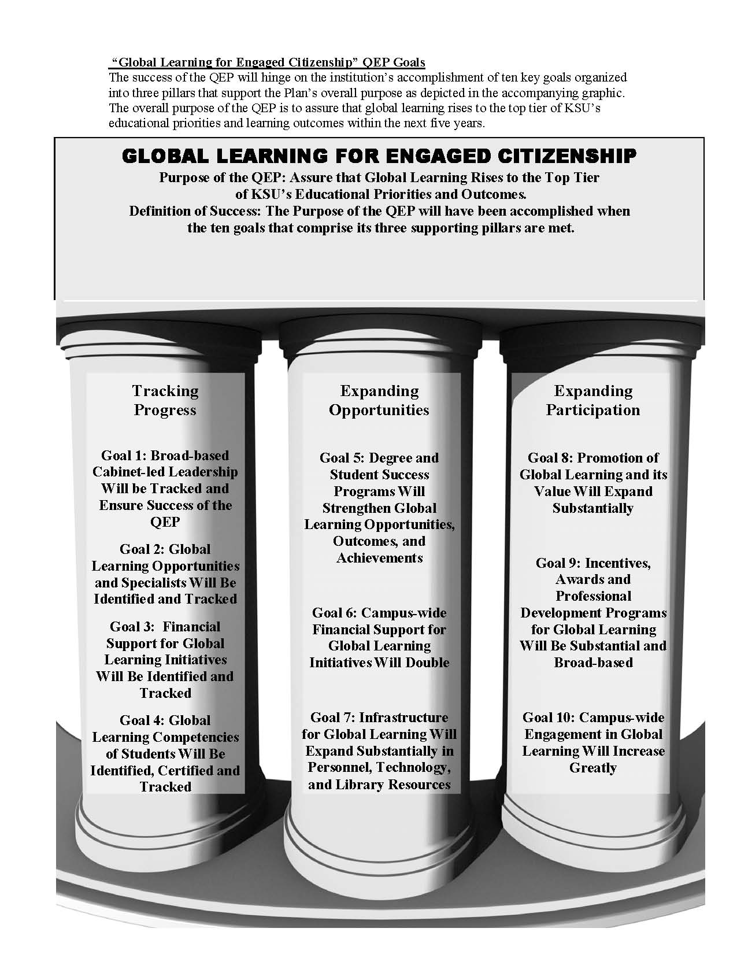
Examples of Focused QEPS
Kennesaw State University
Title: Global Learning for Engaged Citizenship
All initiatives support this one goal

Slide 10
Assessment Issues with GCSU QEP
Learning outcomes were poorly formed
Many were not assessable
Often the means of assessment did not directly relate to the stated learning outcome

Slide 11
Case Study
Initiative 1
Outcome 2: Students will be prepared to learn and to be intellectually challenged. Assessment: Increase in number and retention of transfer students in good academic standing after their first semester.
Outcome 4: Students will experience the benefits of the public liberal arts experience. Assessment: Average transfer student GPA is equivalent to or better than that of generic freshmen at graduation.

Slide 12
Impact on Student Learning
Limited success with Initiatives 1, 2, 3, 4, and 6
Initiative 3 and general education
Greater success with Initiative 5
Broadened as a result of the Strategic Focusing Initiative to include a wider array of LBTC activities
Helped to unite several QEP initiatives, such as Initiative 2 (Leadership) and Initiative 6 (success after graduation/internships, etc.)
GCSU’s Quality Enhancement Plan
Six initiatives to help us better fulfill our mission to “foster excellence and challenge students in the classroom and beyond.”
1) Enhance orientation programs for transfer students
2) Enhance student leadership opportunities
3) Enhance academic challenge within the curriculum to reflect the liberal arts mission
4) Enhance recruitment and retention of students and faculty to increase diversity
5) Enhance opportunities to engage student learning in the classroom and beyond
6) Enhance preparation of students for success in post-graduate opportunities

Slide 13
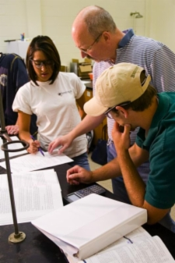
QEP Initiative 5: Results
Enhance Opportunities to Engage Student Learning in the Classroom and Beyond
Outcome 5: Students will interact with instructors outside of the classroom. Assessment: Originally survey of faculty in learning communities, but joint research activities and survey results proved more informative.
259 students gave joint professional presentations and/or publications with faculty.

Slide 14
QEP Initiative 5: Results
Outcome 6: Students will demonstrate crossover learning and apply learning to external situations. Assessment: Originally GPAs, retention rates, and graduation rates of students in learning communities, but increases in LBTC activities and survey results proved better measures.
Student research conference presentations increased from 104 (2006) to 302 (2009).
Service learning hours increased from 12,328 (2006) to 30,000 (2009).
Internships increased by 36 percent (2004-2007).
Study abroad participants increased by 168.87 % since 2003, the largest increase among USG institutions.

Slide 15
QEP Initiative 5: Results
Outcome 2: Students will be involved in campus life. Assessment: Increased participation in campus events and student organizations.
Volunteer hours increased from 33,586 (2006) to 42,500 (2009).
Recipients of the Presidential Service Award (recognizing a minimum of 100 volunteer hours in a year) increased from 4 (2004) to 146 (2009).
472 students participated in leadership activities since 2006.

Slide 16
Indirect Data on LBTC from Surveys
NASPA (National Association of Student Personnel Administrators) Student Voice Survey (2008-2009)
Student responses to the NASPA item, “ As a result of campus activities, I have gained experience/skills relevant to my academic major,” were higher than the national average (p<.05)

Slide 17
Indirect Data on LBTC from Surveys
NSSE 2008 (National Survey of Student Engagement)
Student satisfaction ratings are higher as compared to other benchmark institutions in areas related to learning outcomes 3 (progress towards degree), 4 (collaboration), and 5 (student-faculty interaction).
With the exception of faculty-student interaction, these ratings have increased since 2005

